Slide 1
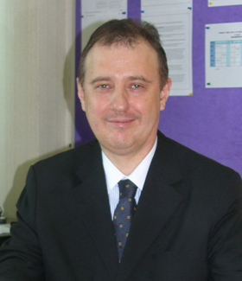
Who will co-ordinate the AEC?
The AEC will be co-ordinated by Mr Andrew Elliott, a Lecturer at SIU’s School of Liberal Arts. Andrew holds degrees in Modern History and Linguistics / Education.
He has worked in various educational fields in Thailand since 1999 and has experience of co-ordinating educational projects here with a range of parties which include over 40 universities, the Ministry of Education, the Office of the Higher Education Commission, the Office for National Education Standards and Quality Assessment, the Ministry of Labour and Social Welfare , the International Schools’ Association of Thailand and the Royal Thai Police.
Andrew’s main role in the AEC will be to liaise with the AEC’s external quality assessors; he will also undertake more general liaison tasks as the AEC requires.
ANDREW ELLIOTT

