Slide 1
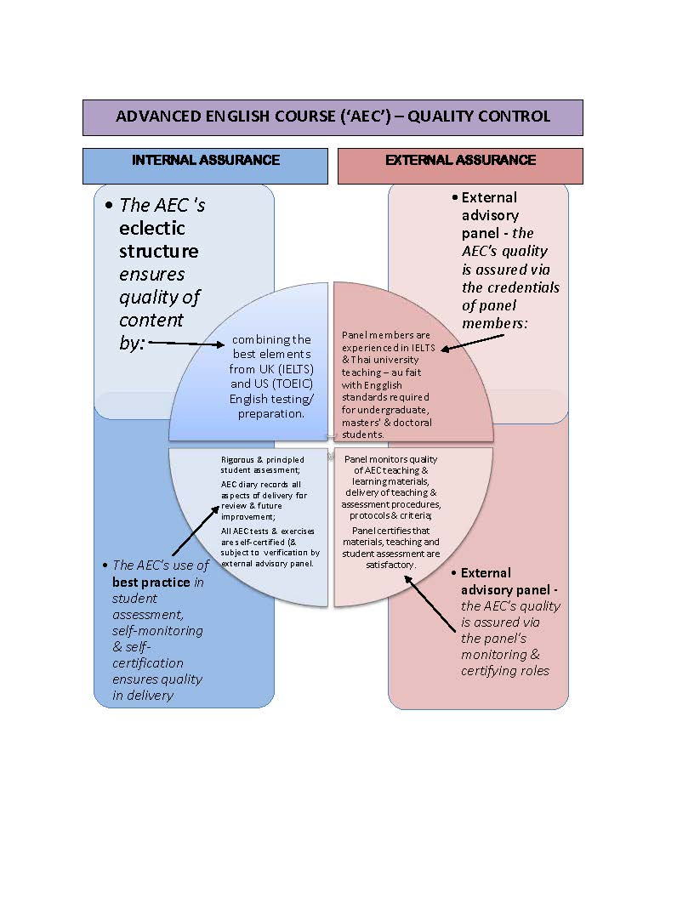
How is the AEC’s quality assured?

